Slide 1
COMP814 Deep Learning I (CNN/RNN)

Slide 2
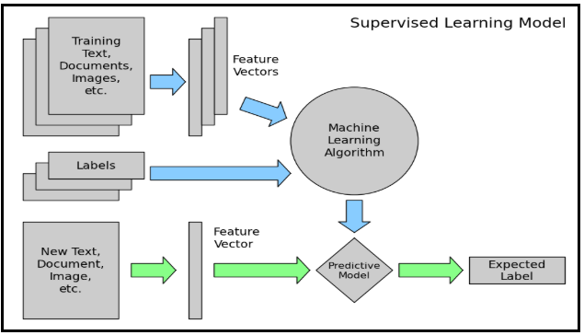
Language Modelling using Deep Learning

Slide 3
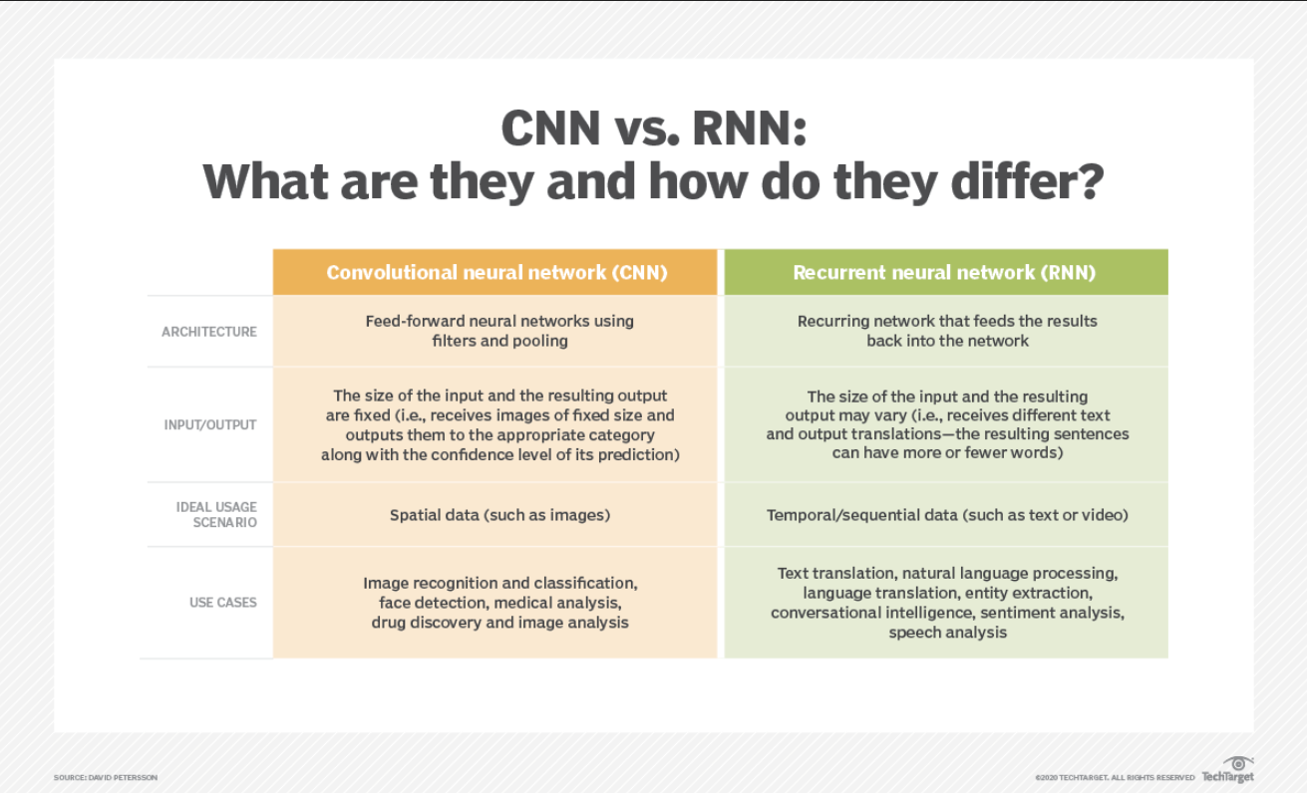
Source Reference

Slide 4
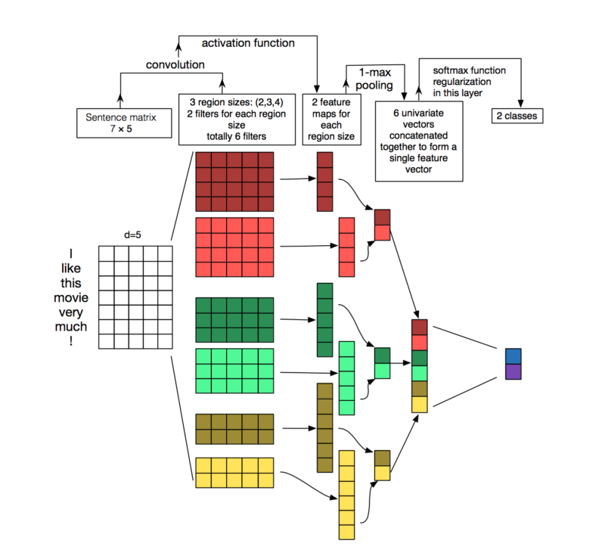
Convolutional Neural Network (CNN)

Slide 5
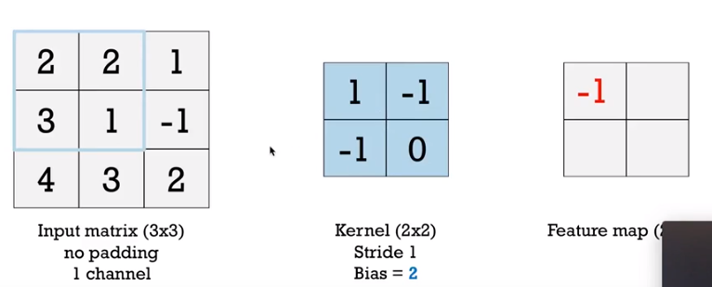

Matrix Convolution
Cross channel sum of the receptor region with a kernel/mask computed over a sliding window given a stride (and padding) plus a bias term.

Slide 6
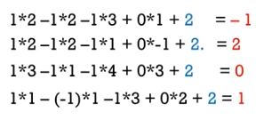
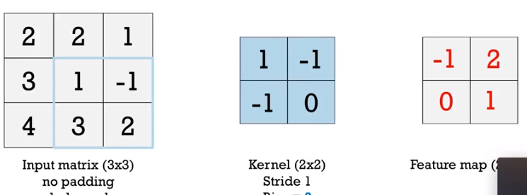
Matrix Convolution
Cross channel sum of the receptor region with a kernel/mask computed over a sliding window given a stride (and padding) plus a bias term.

Slide 7
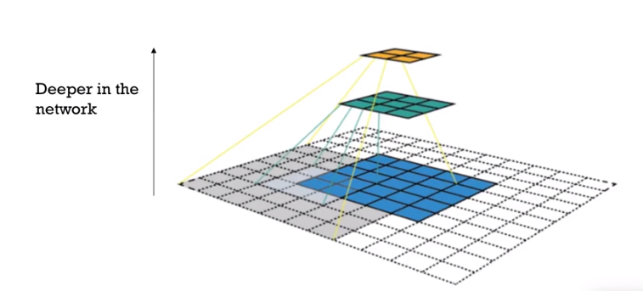
Convolution to reduce dimensions
To prevent combinatorial explosion.

Slide 8
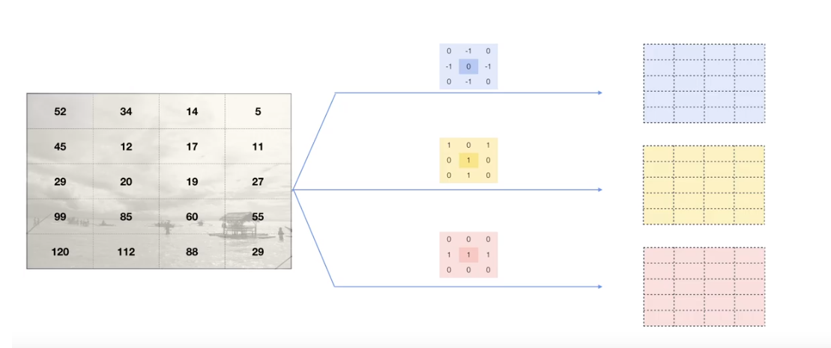
3 convolutions with different kernels

Slide 9
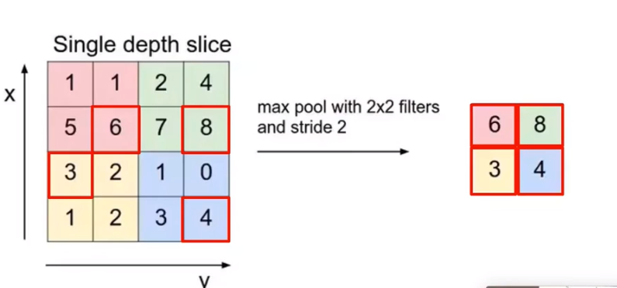
Max pooling

Slide 10
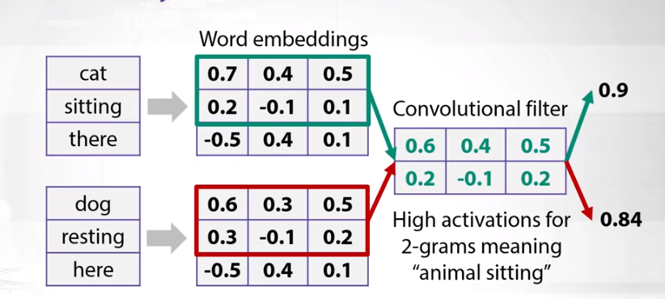
Convolve to lower dimensional matrix

Slide 11
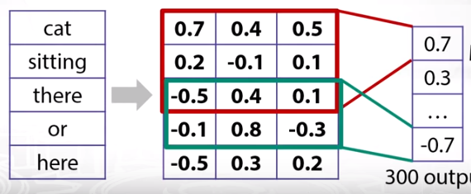
Max pooling

Slide 12
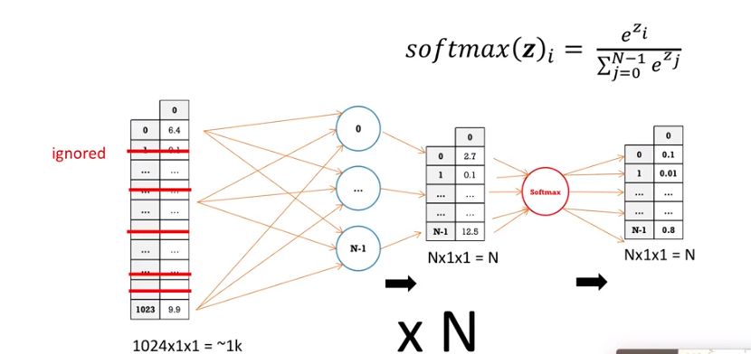
Fully connected neural net at the end.
Flattened matrix, Dropout, softmax for n categories

Slide 13
GloVe: Global Vectors for Word Representation
GloVe is an unsupervised learning algorithm for obtaining vector representations for words. Training is performed on aggregated global word-word co-occurrence statistics from a corpus, and the resulting representations showcase interesting linear substructures of the word vector space.
Can download the embedding to plug into CNN models instead of training your own.
https://nlp.stanford.edu/projects/glove/

Slide 14
CNN Summary
Word embedding
N-grams
Sliding window
Strides
Kernels
Max pooling
Activation functions
Flattened matrix
Fully connected NN
dropout
Softmax function
Back propagation
Loss function

Slide 15
Recurrent Neural Networks (RNN)

Slide 16
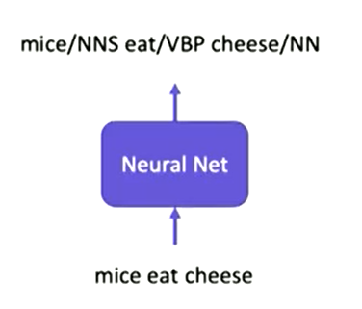
Neural Network
Sequence to sequence model
NN as a black box
outputs one sequence from another
Source → Target

Slide 17
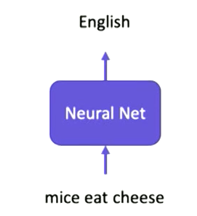
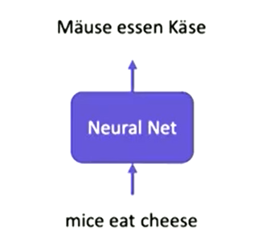
Seq -> Seq

Slide 18
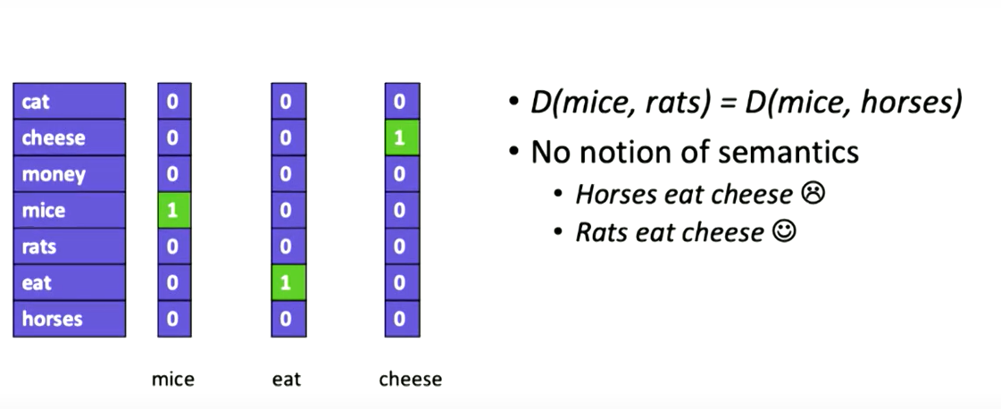
How do we represent words
One hot representation
No semantic representation

Slide 19
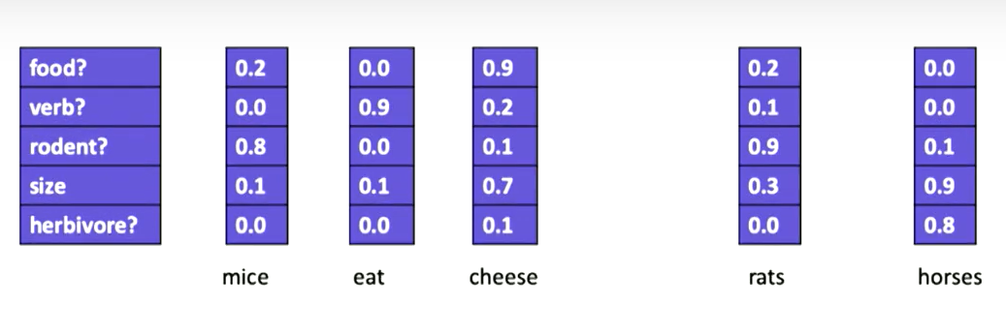
Word Embedding
Enables Semantics
Enables us to compute distance between words
Similarity
E.g. Euclidian distance, Cosine distance (dot product)

Slide 20
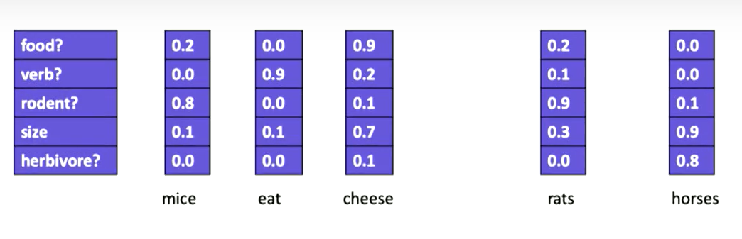

Slide 21
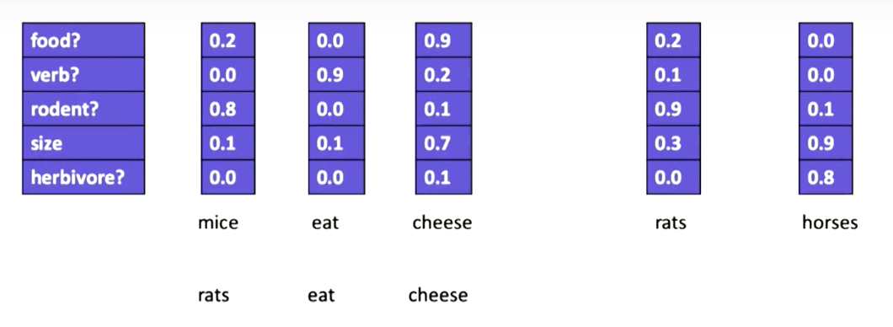

Slide 22
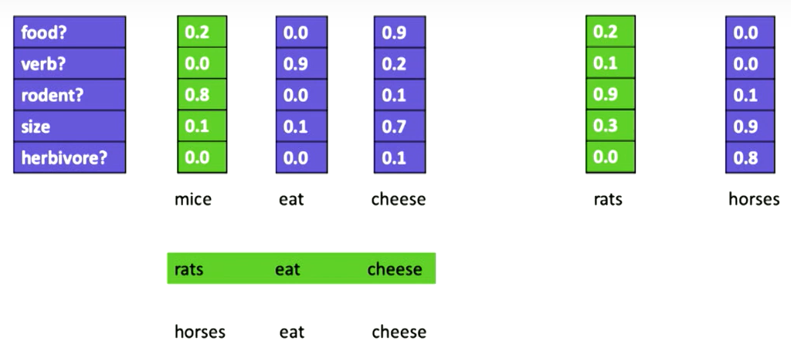

Slide 23
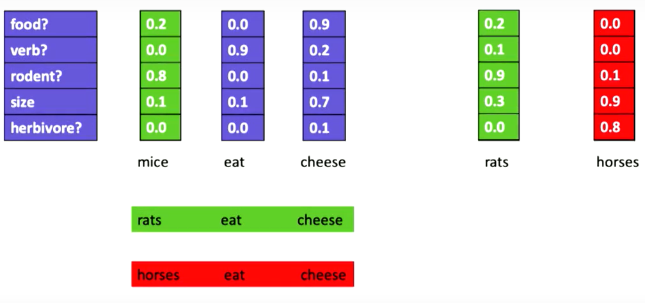

Slide 24
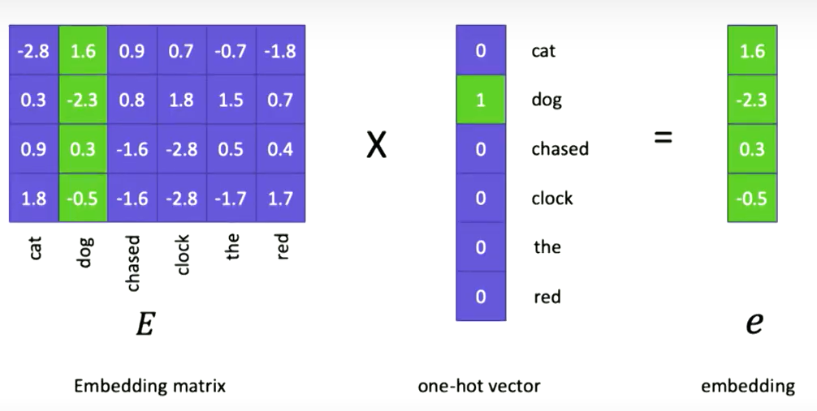
Extracting the embedded vector from one hot representation.

Slide 25
RNN language model
RNN (Recurrent Neural Network)
Has a connection from the previous state to the next state.
This represents the current output is dependent on the previous one/s.
Good model for a sequence such as a sequence model.
Typical task is to predict the next word given a partial sequence.

Slide 26
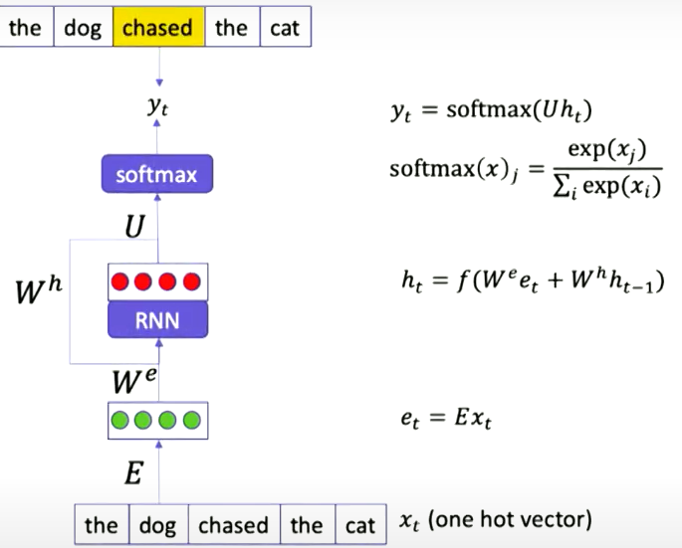
RNN…
(One hot vector)
(Hidden state)
Hidden state at previous time stamp
(Embedding vector)

Slide 27
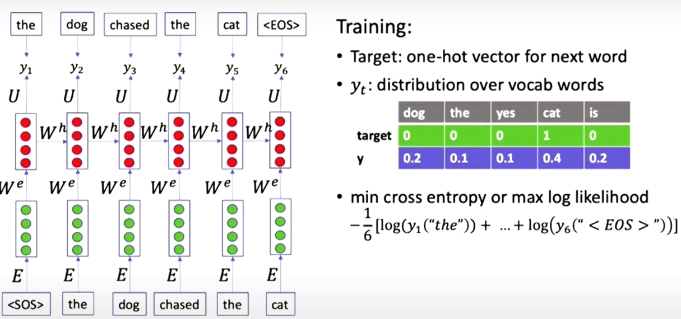
RNN…
Shared weight matrix
(previous hidden state passed on to next)

Slide 28
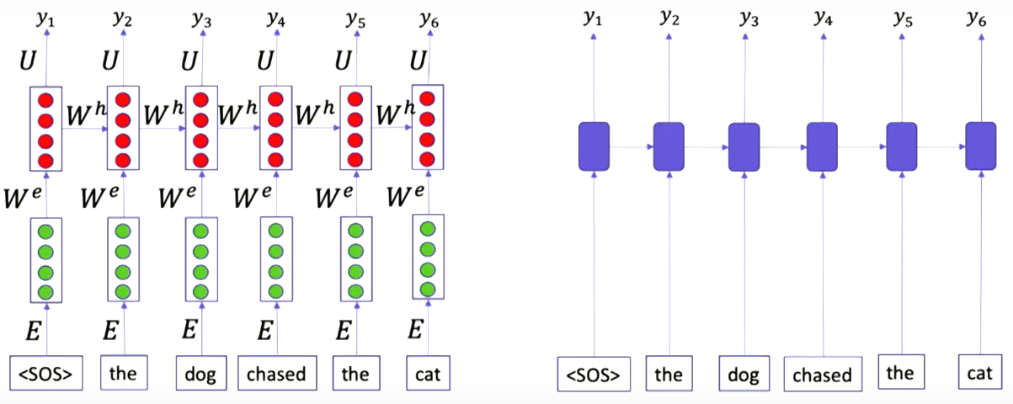
RNN…

Slide 29
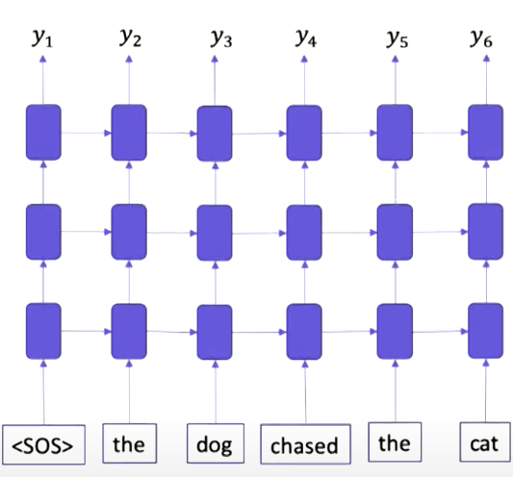
RNN…
Multiple layers
Deep NN
More expressive power

Slide 30
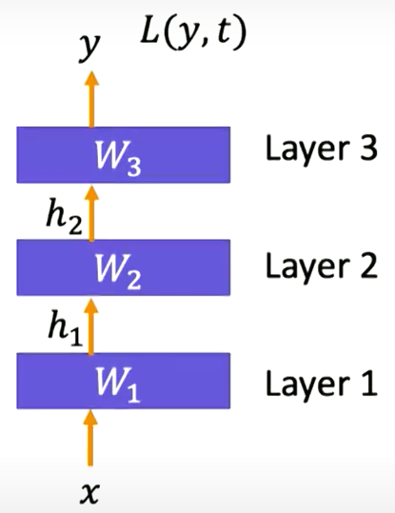
RNN…
Back propagation
Occurs at a single timestep
Also occurs at the subsequent timesteps.
(Loss function)

Slide 31
RNN…
The depth is (can be) as long as the sequence
But the weights are shared
Problem: vanishing gradient
No slope in the error function over “very long distances”
Solution: instead of backpropagating through all layers, only do it, say 3 layers at a time and then feedforward the hidden state from the last 3 layers.
Distance reduced to 3.

Slide 32
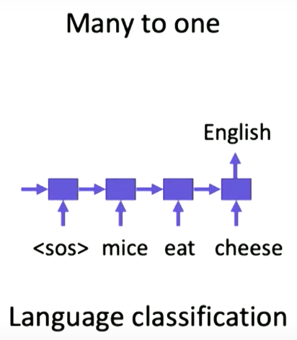
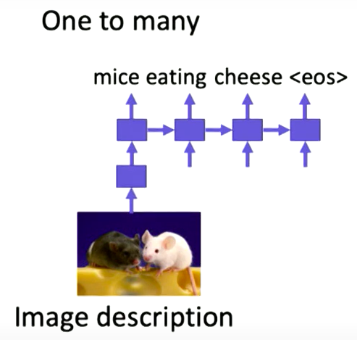
RNN Applications

Slide 33
Demo Code
Dataset for Demo
Glove Embedding Matrix

